Slide 1




Vital Signs: The Campaign to Prevent Physician Suicide

Slide 2



Physicians have one of the highest suicide rates of any profession. More than half of physicians know a physician who has either considered, attempted or died by suicide in their career. It’s estimated that one million Americans lose their physician to suicide each year.
We can all help prevent physician suicide.
Physicians are experiencing practice environments like they never had before -- early physician retirement, health care worker shortages and a growing inequity experienced by patients. Understandably, this has taken a toll on their mental health and contributes to burnout rates.
National Physician Suicide Awareness Day (#NPSADay) is a reminder and call to action. It's a time to talk – and to act – so physicians’ struggles don't become mental health emergencies. We can all help prevent physician suicide by learning the signs, starting the conversations, creating a culture of wellbeing, removing intrusive mental health questions from applications and sharing the resources that can help those in distress seek mental health care.

Slide 3

7 Actions You Can Take
Learn the Vital Signs
Encourage mental health reflection
Share suicide prevention resources
Prepare before a moment of crisis
Check in with a physician
Remove intrusive mental health questions
Create a culture of wellbeing

Slide 4


Slide 5

Learn the Warning Signs with the Vital Signs’ HEART Acronym
Vital Sign 1: Health
  Increasing the use of medications and/or alcohol or illicit drugs
  Talking about wanting to hurt themselves or die

Slide 6

Learn the Warning Signs with the Vital Signs’ HEART Acronym
Vital Sign 2: Emotions
  Experiencing extreme mood swings
  Feeling hopeless or having no purpose

Slide 7

Learn the Warning Signs with the Vital Signs’ HEART Acronym
Vital Sign 3: Attitude
  Being negative about professional and personal life
  Having inappropriate outbursts of anger or sadness

Slide 8

Learn the Warning Signs with the Vital Signs’ HEART Acronym
Vital Sign 4: Relationships
  Withdrawing or isolating themselves from family, friends and coworkers
  Talking about being a burden to others

Slide 9

Learn the Warning Signs with the Vital Signs’ HEART Acronym
Vital Sign 5: Temperament
  Acting anxious or agitated; behaving recklessly
  Being uncomfortable, tired or in unbearable pain

Slide 10
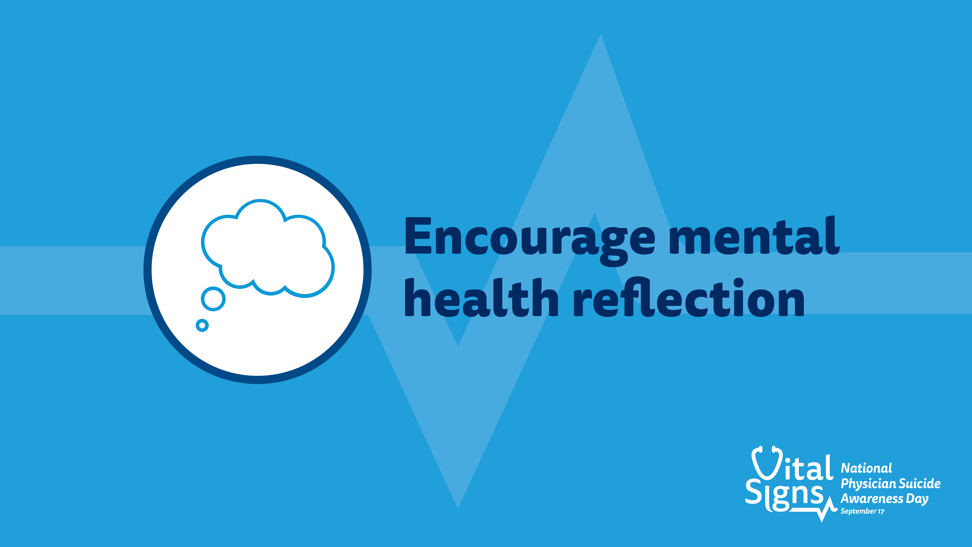

Slide 11


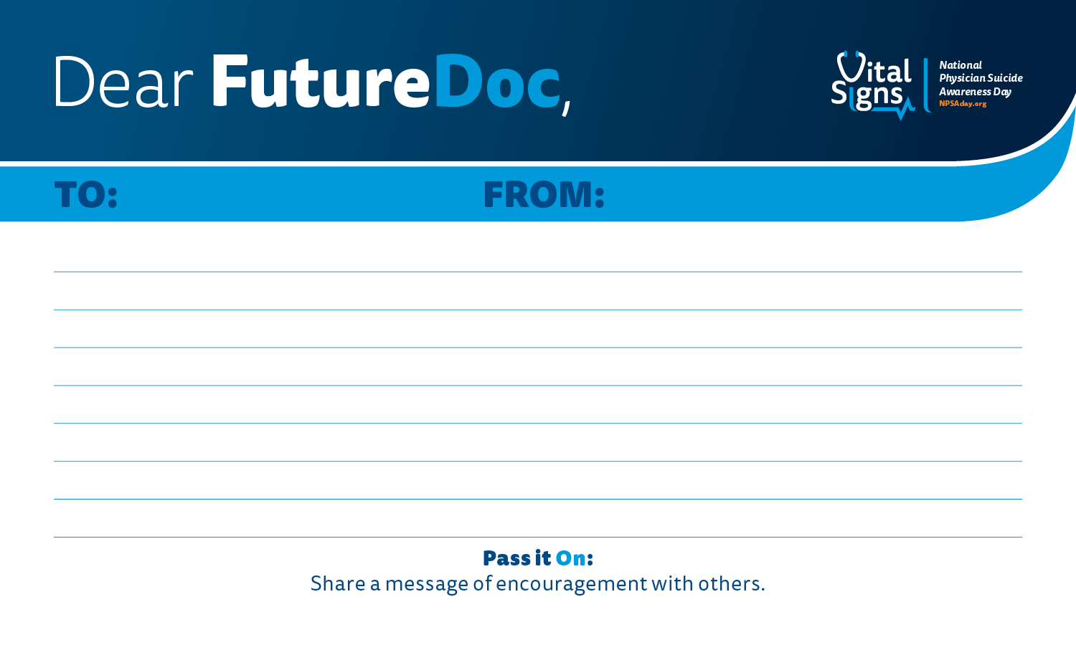
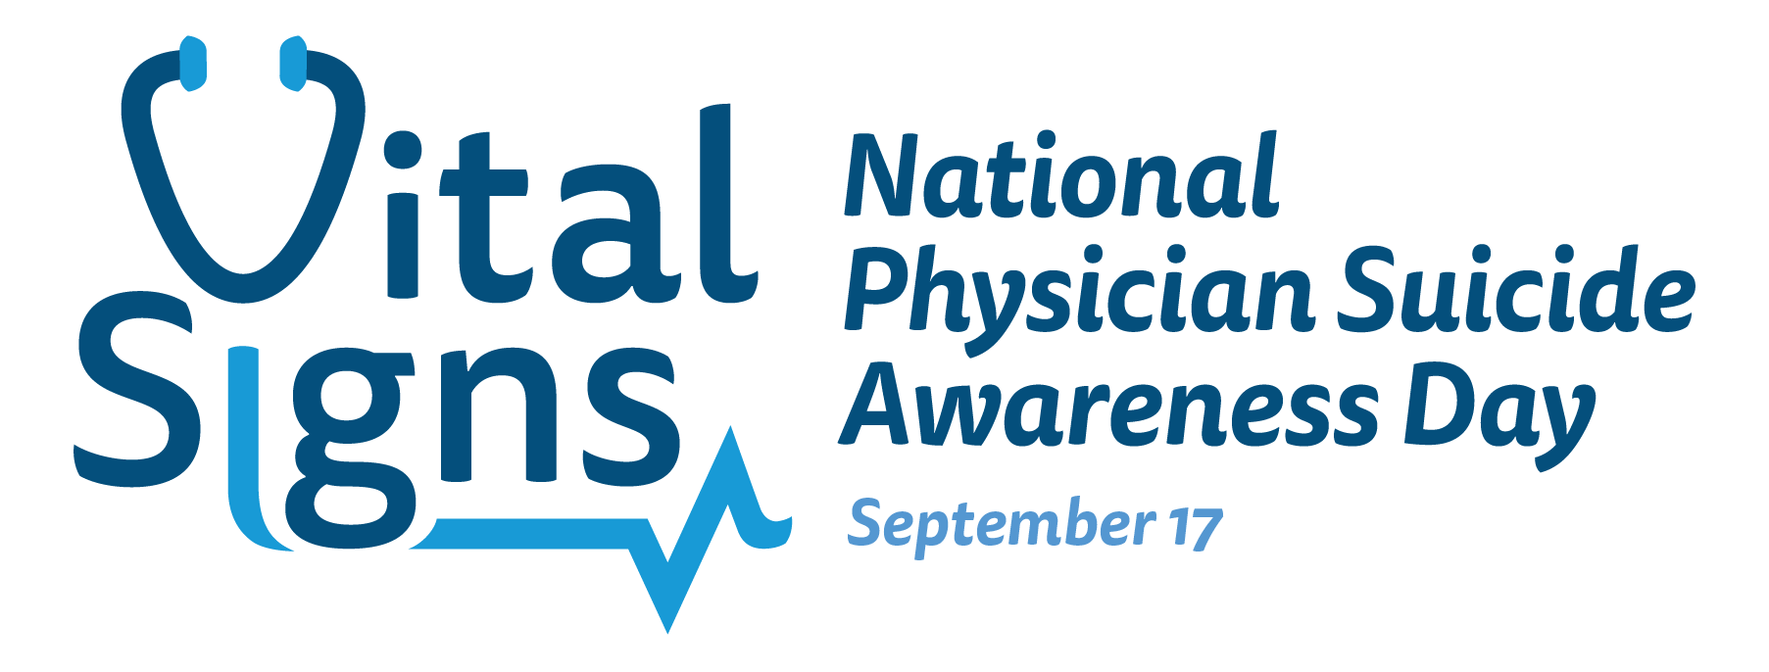
Encourage Mental Health Reflection
Dear FutureDoc allows medical students, residents and physicians an opportunity to:
Reflect on your own mental health and wellbeing using Dear Future MD notecards to write a message to your future self.
Reflect on your wellbeing hope for physicians in 2043.

Slide 12
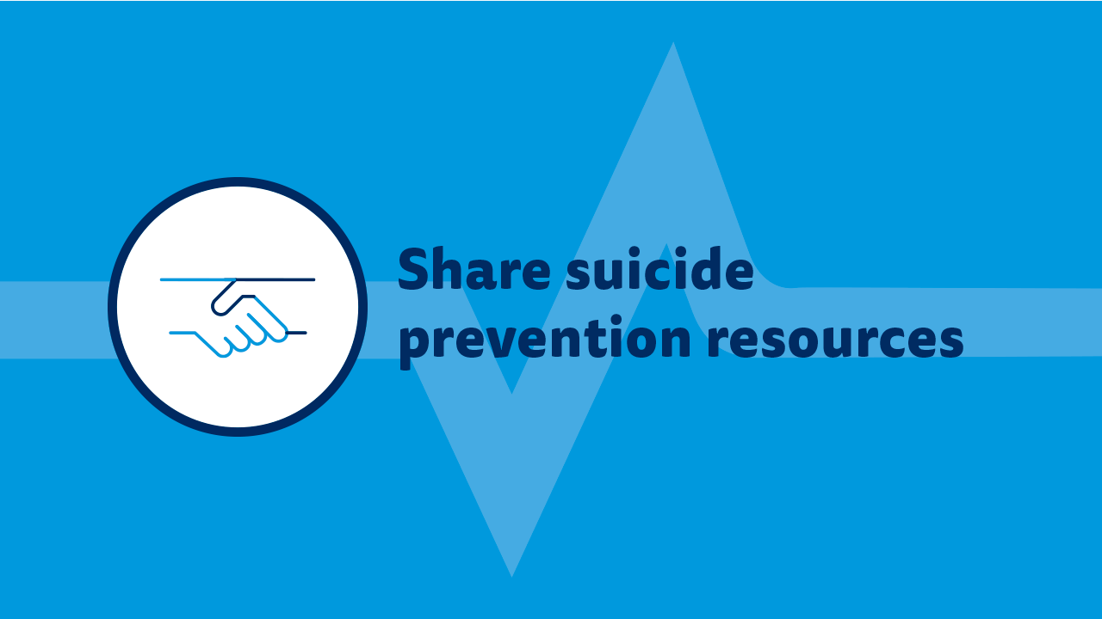

Slide 13
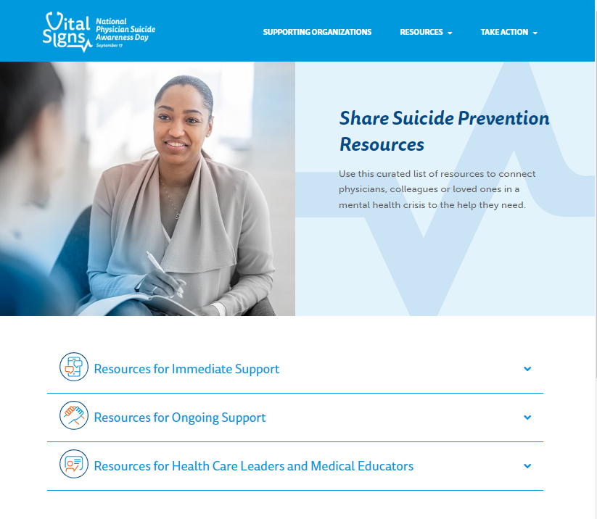
Share Suicide Prevention Resources
Stressors are inevitable in the field of medicine, but many prevention resources can help provide support.
If you or someone you know is struggling or in crisis, call or text 988 or chat 988lifeline.org

Slide 14
Resources for Immediate Support
Physician Support Line is a national, free and confidential support line service made up of 600+ volunteer psychiatrists to provide peer support for physician colleagues and American medical students. Call 1-888-409-0141. It’s open 8am to 1am every day, no appointment necessary.
National Alliance on Mental Illness Crisis Text Line offers free 24/7 mental health support. Text “SCRUBS” to 741741 for help.
Resources for Ongoing Support
Therapy Aid Coalition provides free therapy for physicians, health care professionals and first responders, including individual and group support.
The Emotional PPE Project connects physicians and other health care workers with licensed mental health professionals who can help. This service is free and does not require insurance.
Each state also has its own Physician Health Program. To find your state’s, visit Federation of State Physician Health Programs.
PeerRxMed is a free peer-to-peer program for physicians and other health care professionals that offers support, connection, encouragement, resources and skill building for optimal well-being.

Slide 15
Resources for Health Care Leaders and Medical Educators
On Demand
Institute for Clinical Systems Improvement (ISCI) Playbook is a playbook for healthcare leaders that presents key themes and suggestions based on research on healthcare worker well-being. It includes a new framework for thinking about workforce well-being from a systems perspective, examples of specific efforts and prompts to help healthcare leaders apply information to their organizations.
American Medical Association (AMA) Steps Forward: Preventing physician Suicide is a learning module from the AMA which includes a toolkit and quiz about identifying risk factors and warning signs for suicide, applying standardized processes for physicians seeking support and creating an environment of support and wellness within an organization. It offers 0.5 CME credits.
American Medical Association (AMA) Steps Forward: Recognize and Respond Early to Stress Injuries is a learning module from the AMA which includes toolkits and a quiz about how to recognize stress injuries in health care professionals, how to administer Stress First Aid at the individual level and how to use Stress First Aid as a method of peer support at the organizational level. It offers 0.5 CME credits.
American Hospital Association Suicide Prevention in the Health Care Workforce Guide offers resources that make it easier for hospitals and health systems to discover proven strategies and deploy best practices that improve the mental health and wellbeing of their staff, including three main drivers of suicide in the health care workforce.

Slide 16
Resources for Healthcare Leaders and Medical Educators
Membership Programs for Workforce Wellbeing
American Medical Association Joy in Medicine is a recognition program for health systems designed to spark and guide organizations interested, committed or already engaged in improving physician satisfaction and reducing burnout.
Interactive Screening Program is an online intervention program from the American Foundation for Suicide Prevention that medical schools, hospitals and health systems can sign up to implement as part of their ongoing mental health promotion and suicide prevention efforts.
Schwartz Rounds offers healthcare professionals a regularly scheduled time during their fast-paced work lives to openly and honestly discuss the social and emotional issues they face in caring for patients and families.
Stress First Aid provides a framework for psychological peer support, with a set of supportive actions designed to promote self-care and coworker support with the aim of mitigating the negative impacts of stress at work before they impair staff health and well-being

Slide 17
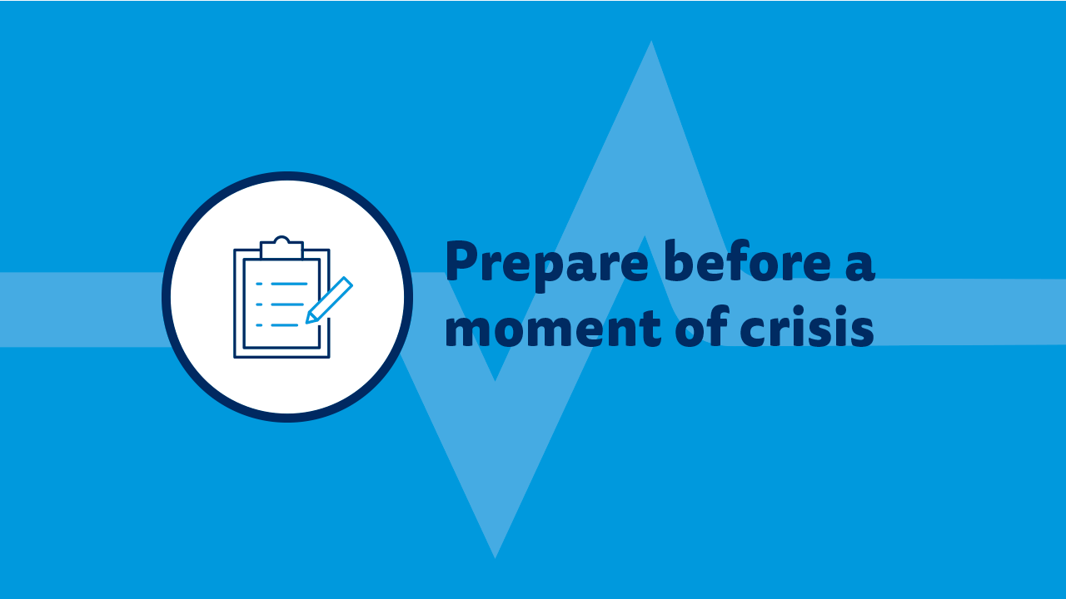

Slide 18
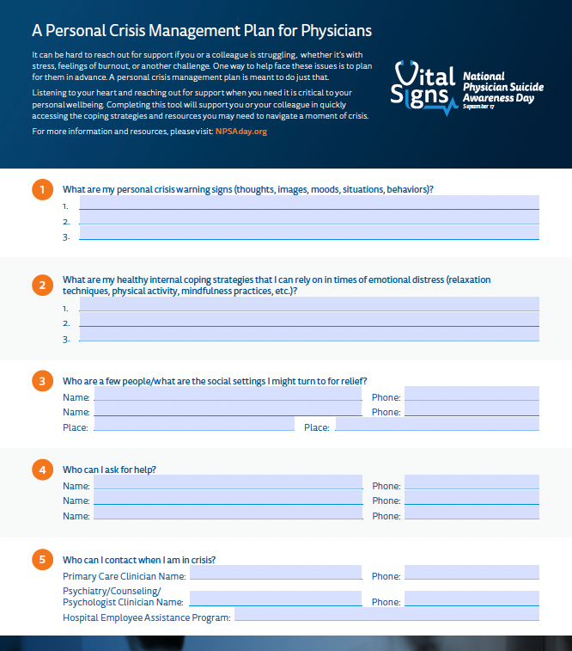
Prepare Before a Moment of Crisis
It can be hard to reach out for support if you or a colleague is struggling, whether it’s with stress, feelings of burnout or another challenge.
One way to help face these issues is to plan for them in advance. A personal crisis management plan is meant to do just that.

Slide 19
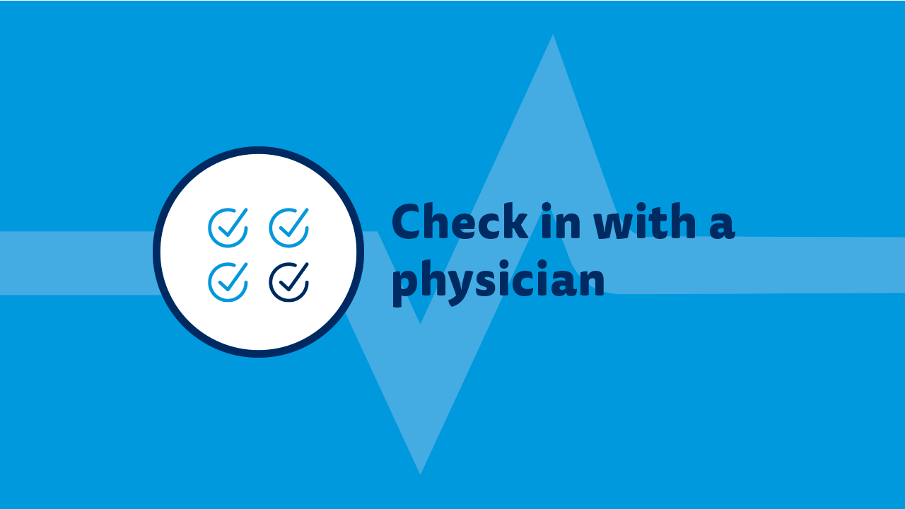

Slide 20
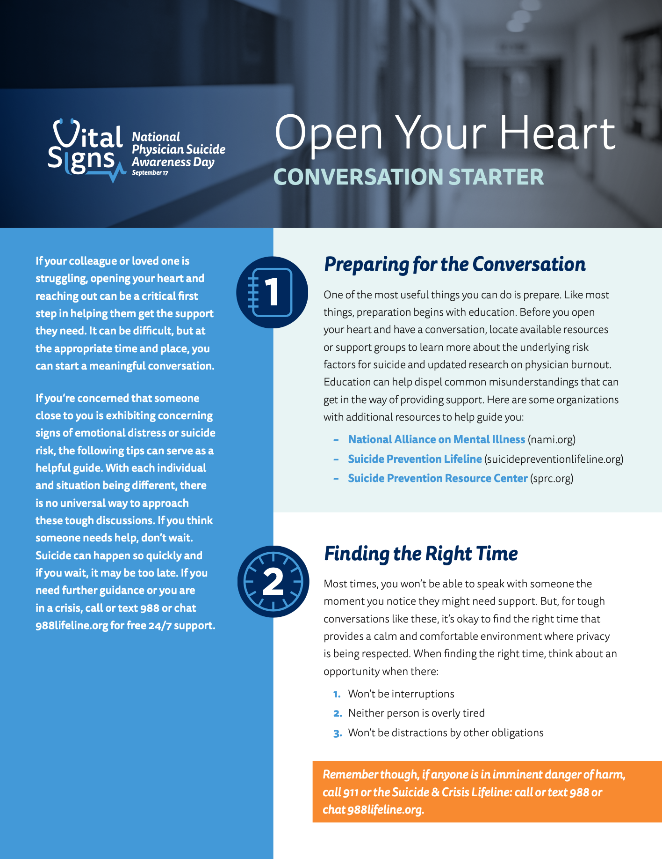
Start a Meaningful Conversation
1. Prepare for the conversation
2. Find the right time
3. Choose the right language
4. Listen, actively
5. Navigate resistance

Slide 21
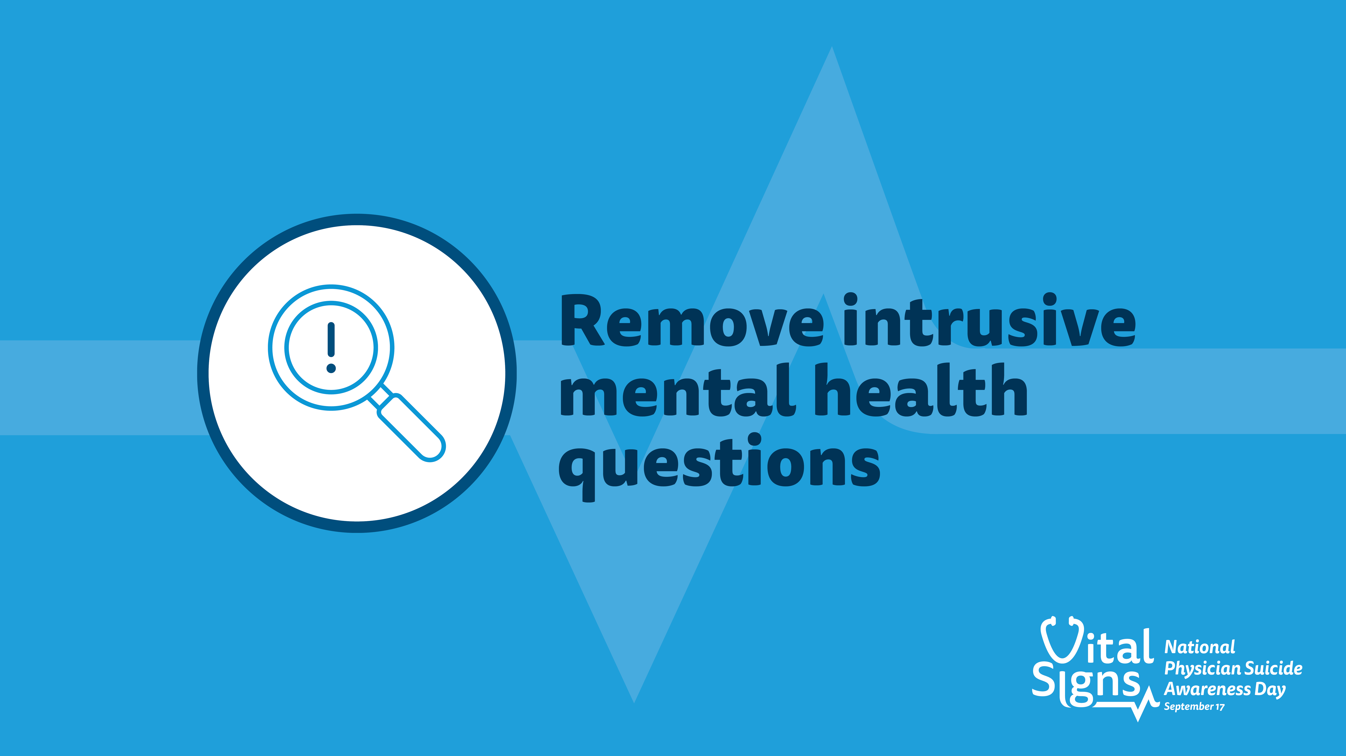

Slide 22
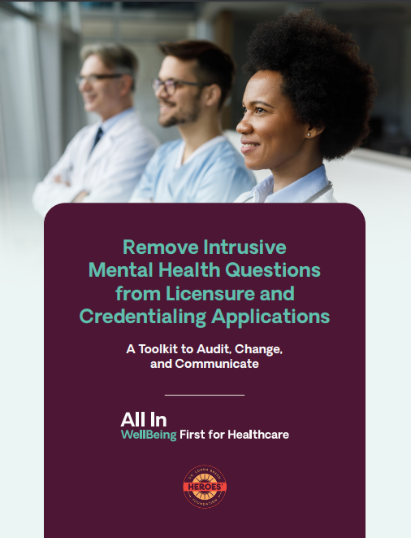
Remove Intrusive Mental Health Questions
3 Steps Boards and Hospitals/Health Systems Can Take
AUDIT all licensure and credentialing applications, addendums and peer review forms
CHANGE any invasive or stigmatizing language around mental health
COMMUNICATE these changes to your workforce and assure clinicians that it is safe for them to seek care

Slide 23
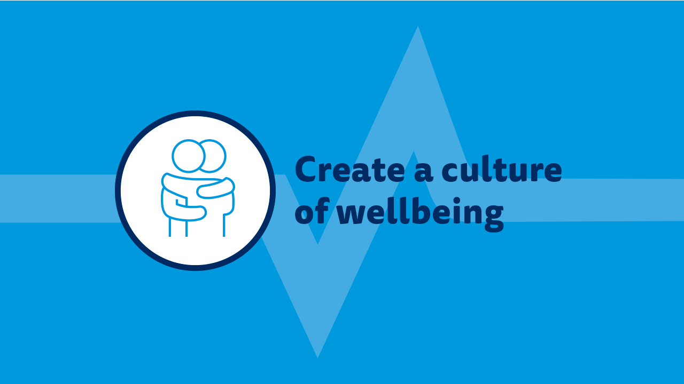

Slide 24


Create a Culture of Wellbeing
ALL IN: Caring for Caregivers is a program for organizations to improve the professional well-being and mental health of health workers. It includes three main phases:
1) Commitments by Medical Groups, Hospitals, Health Systems, Health Plans
2) Digital Programming – Symphony
3) Focus on Operations and Participate in Learning Communities

Slide 25
Get Help
If you or someone you know is struggling or in crisis, call or text 988 or chat 988lifeline.org

Slide 26

Join us in preventing physician suicide.
Become a Supporting Organization at NPSADay.org/become-supporting-organization
Reach out and engage physicians, their loved ones, their colleagues, health organizations or others in your network to join us in recognizing #NPSADay.
Access at NPSADay.org/toolkit:
Guides to help you plan how to recognize #NPSADay
Shareable materials to recognize #NPSADay and encourage others to help prevent physician suicide
Brought to you by:

