Slide 1




Vital Signs: The Campaign to Prevent Physician Suicide

Slide 2



Physicians have one of the highest suicide rates of any profession. More than half of physicians know a physician who has either considered, attempted or died by suicide in their career. It’s estimated that one million Americans lose their physician to suicide each year.
We can all help prevent physician suicide.
While physician suicide was a crisis long before COVID-19, the demands of the pandemic has created a sense of urgency to better support physicians’ mental health and wellbeing.
National Physician Suicide Awareness Day (#NPSADay) is a reminder and call to action. It's a time to talk – and to act – so physicians’ struggles don't become mental health emergencies. We can all help prevent physician suicide by learning the signs, starting the conversations, understanding the underlying barriers and sharing the resources that can help those in distress seek mental health care.

Slide 3

6 Actions You Can Take
Learn the Vital Signs
Share suicide prevention resources
Prepare before a moment of crisis
Check in with a physician
Understand structural barriers
Create a culture of wellbeing

Slide 4
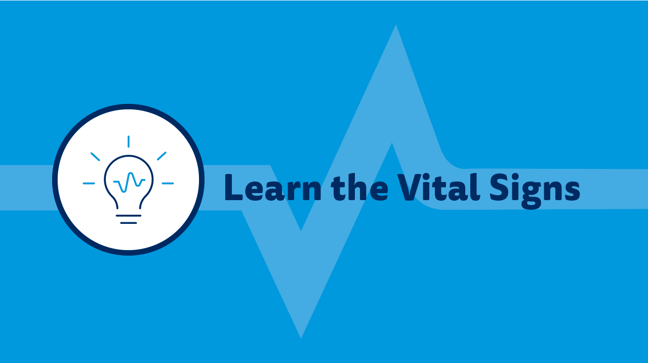

Slide 5

Learn the Warning Signs with the Vital Signs’ HEART Acronym
Vital Sign 1: Health
  Increasing the use of medications and/or alcohol or illicit drugs
  Talking about wanting to hurt themselves or die

Slide 6
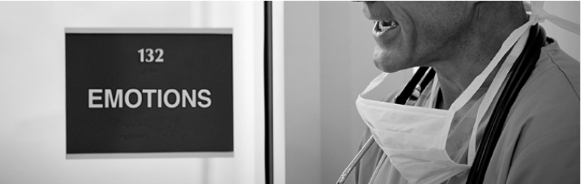
Learn the Warning Signs with the Vital Signs’ HEART Acronym
Vital Sign 2: Emotions
  Experiencing extreme mood swings
  Feeling hopeless or having no purpose

Slide 7

Learn the Warning Signs with the Vital Signs’ HEART Acronym
Vital Sign 3: Attitude
  Being negative about professional and personal life
  Having inappropriate outbursts of anger or sadness

Slide 8

Learn the Warning Signs with the Vital Signs’ HEART Acronym
Vital Sign 4: Relationships
  Withdrawing or isolating themselves from family, friends and coworkers
  Talking about being a burden to others

Slide 9

Learn the Warning Signs with the Vital Signs’ HEART Acronym
Vital Sign 5: Temperament
  Acting anxious or agitated; behaving recklessly
  Being uncomfortable, tired or in unbearable pain

Slide 10
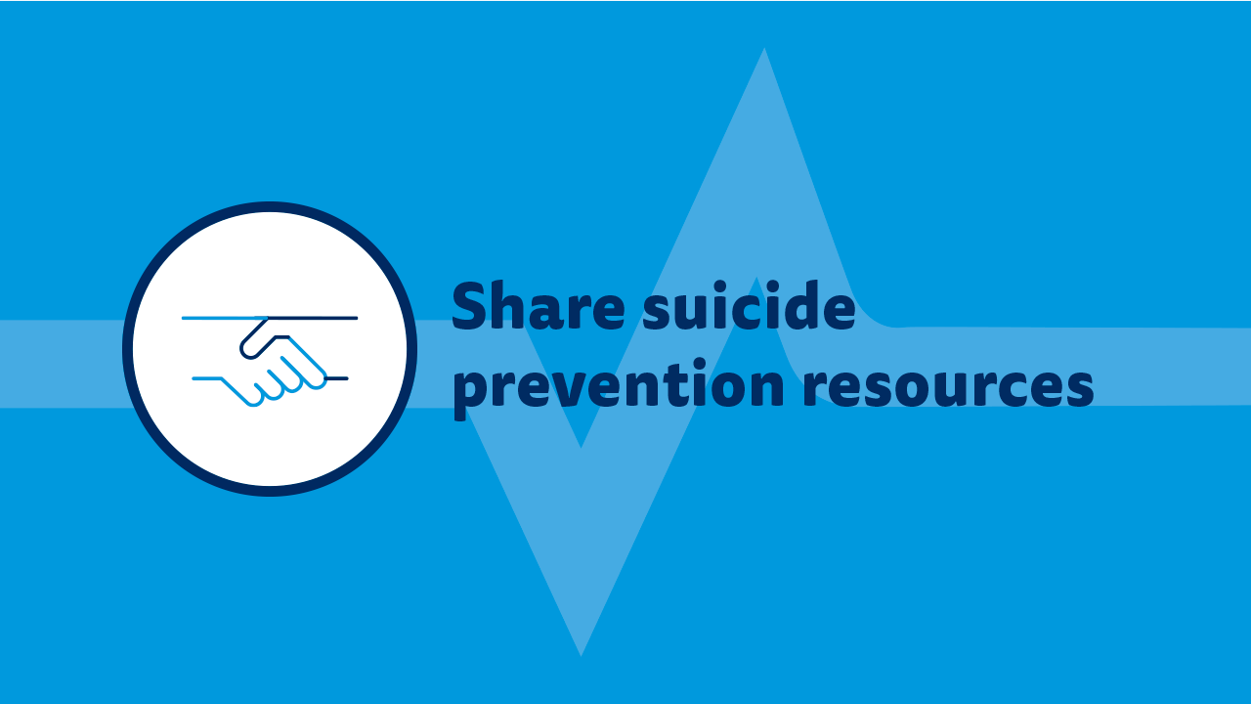

Slide 11
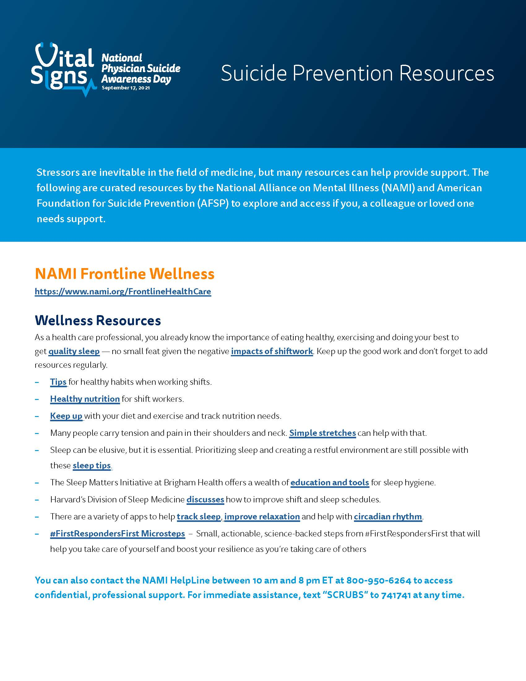
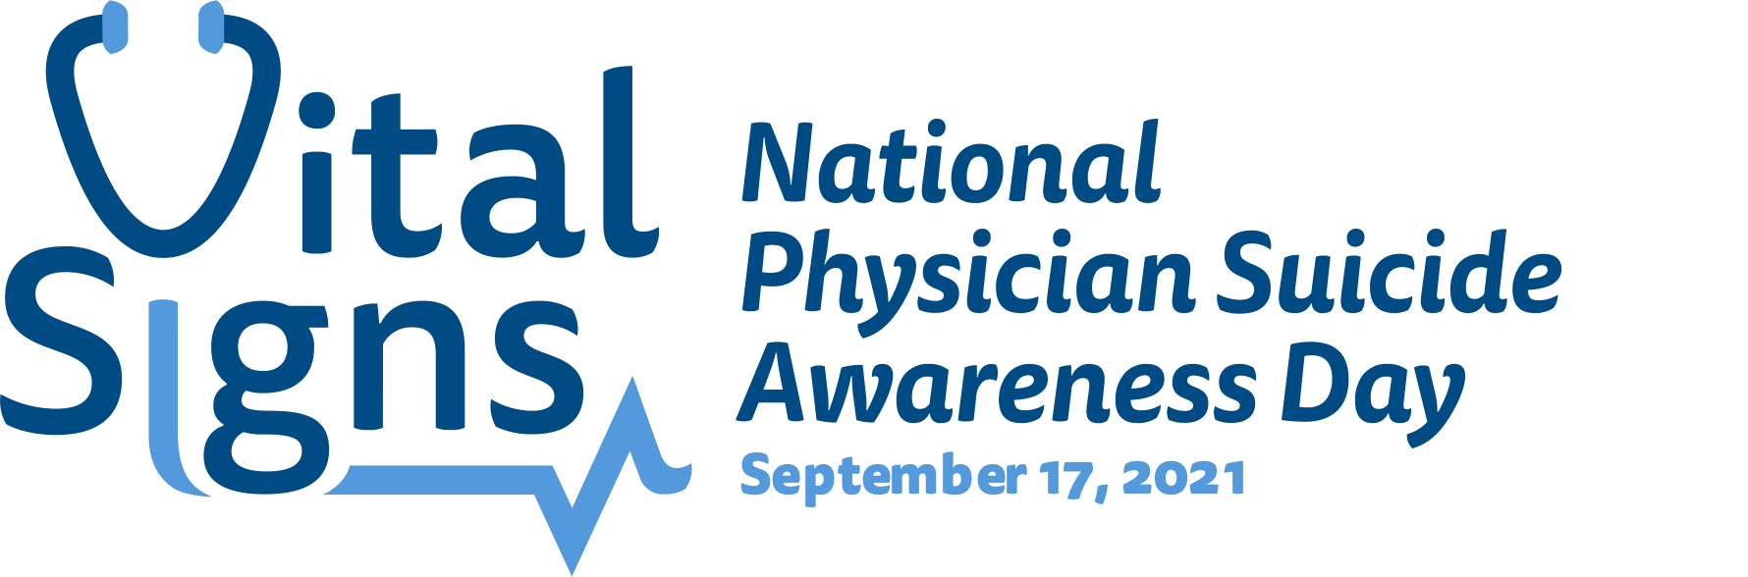
Share Suicide Prevention Resources
Stressors are inevitable in the field of medicine, but many prevention resources can help provide support.

Slide 12
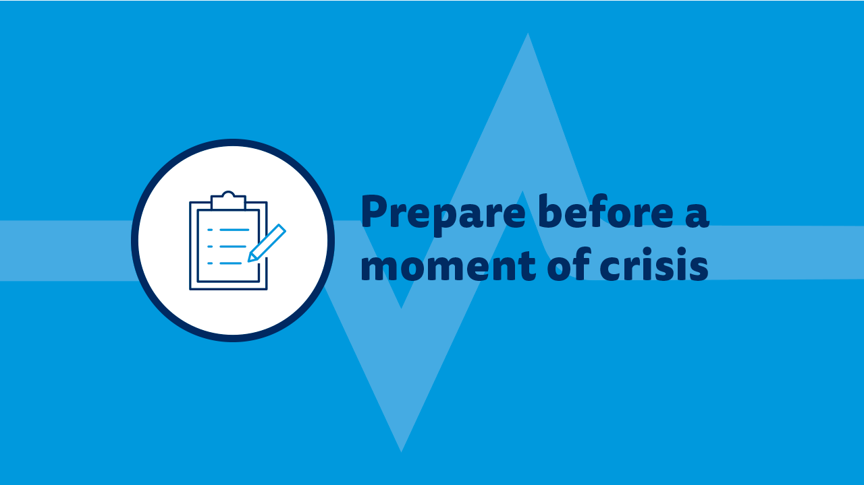

Slide 13
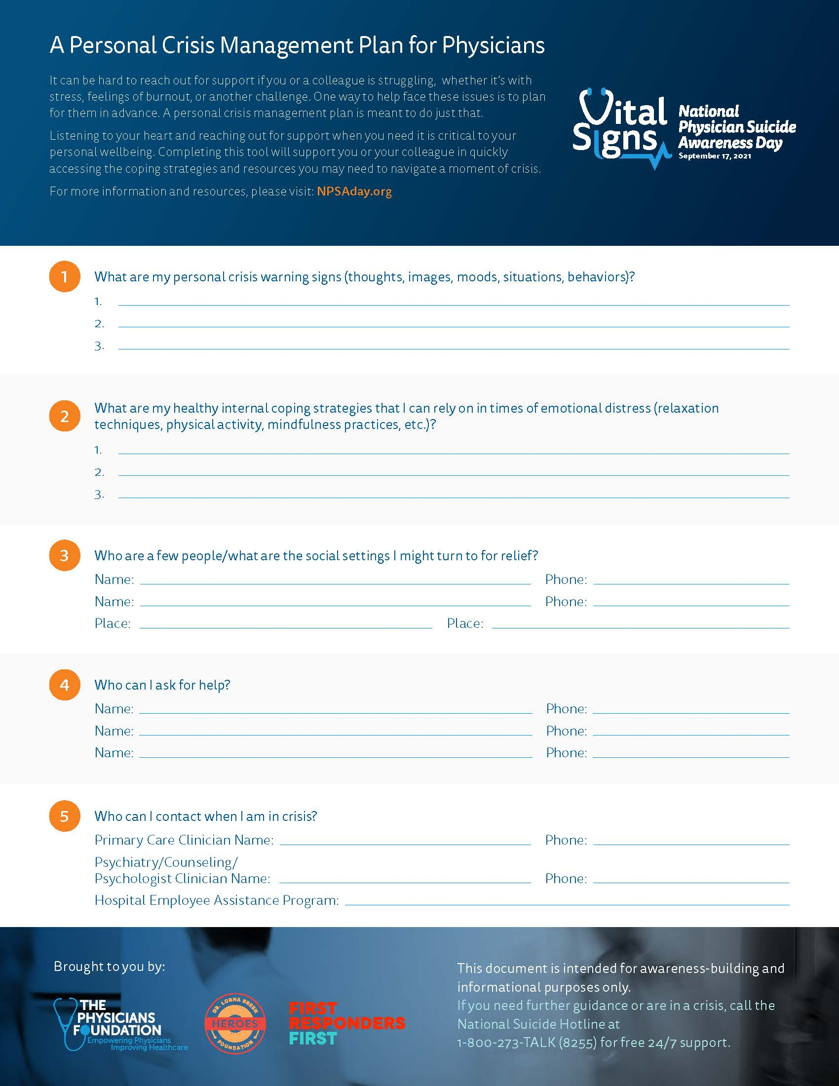
Prepare Before a Moment of Crisis
It can be hard to reach out for support if you or a colleague is struggling, whether it’s with stress, feelings of burnout or another challenge.
One way to help face these issues is to plan for them in advance. A personal crisis management plan is meant to do just that.

Slide 14
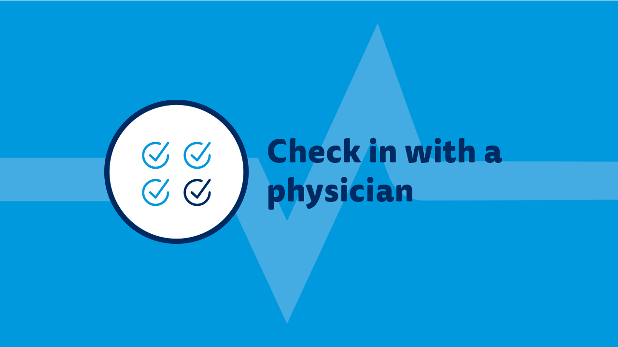

Slide 15
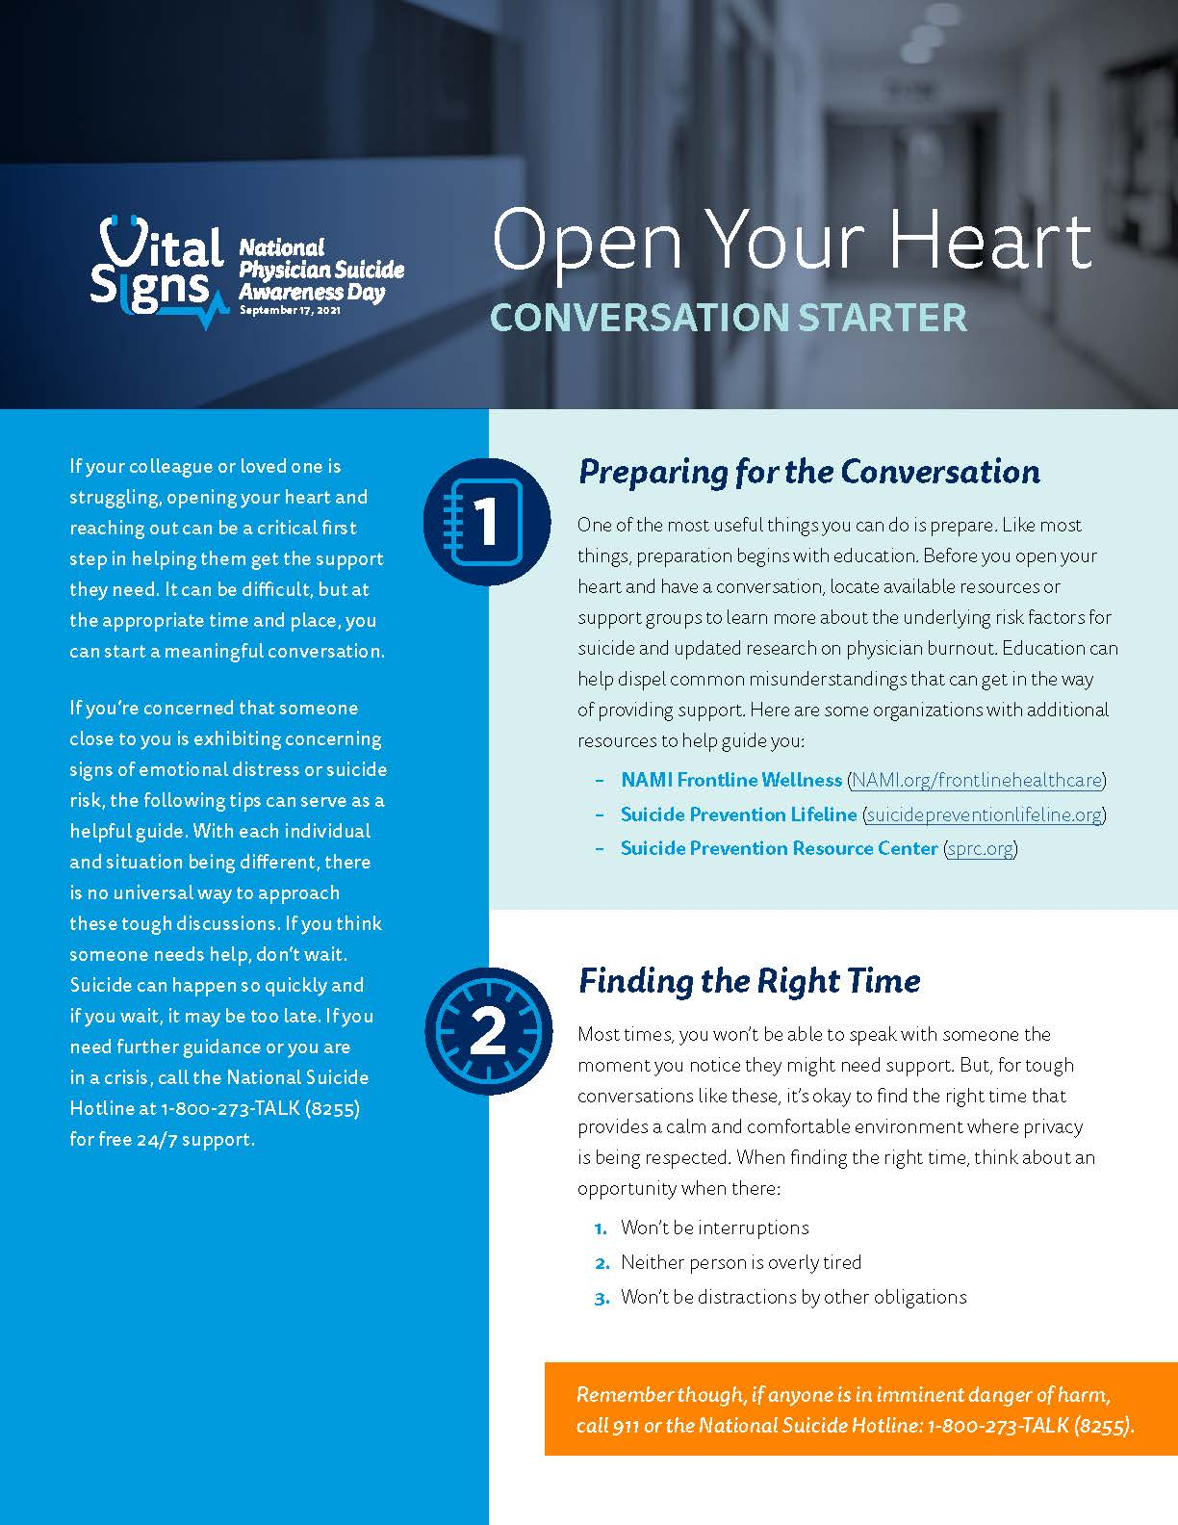
Start a Meaningful Conversation
1. Prepare for the conversation
2. Find the right time
3. Choose the right language
4. Listen, actively
5. Navigate resistance

Slide 16
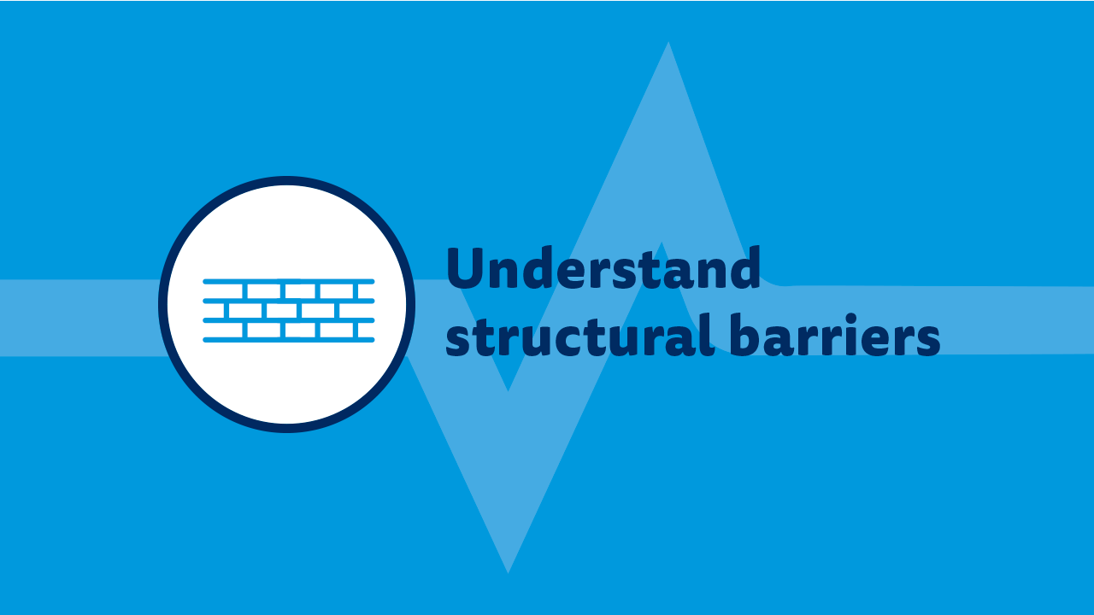

Slide 17
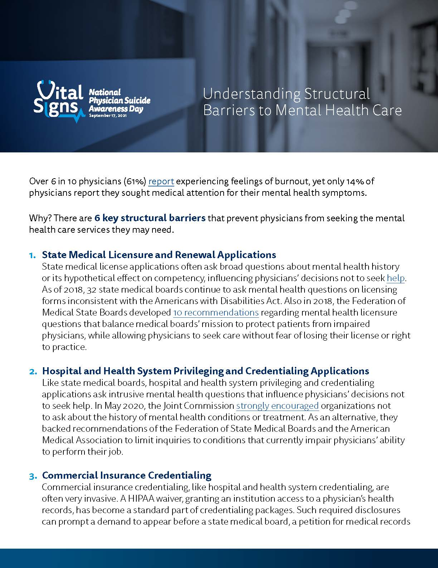
Understand Structural Barriers
State Medical Licensure & Renewal Applications
Hospital & Health System Privileging & Credentialing Applications
Commercial Insurance Credentialing
Malpractice Insurance Application
Legal Discovery Process During Lawsuits
Mental Health Insurance Requiring Treatment Where the Physician Works

Slide 18


Slide 19
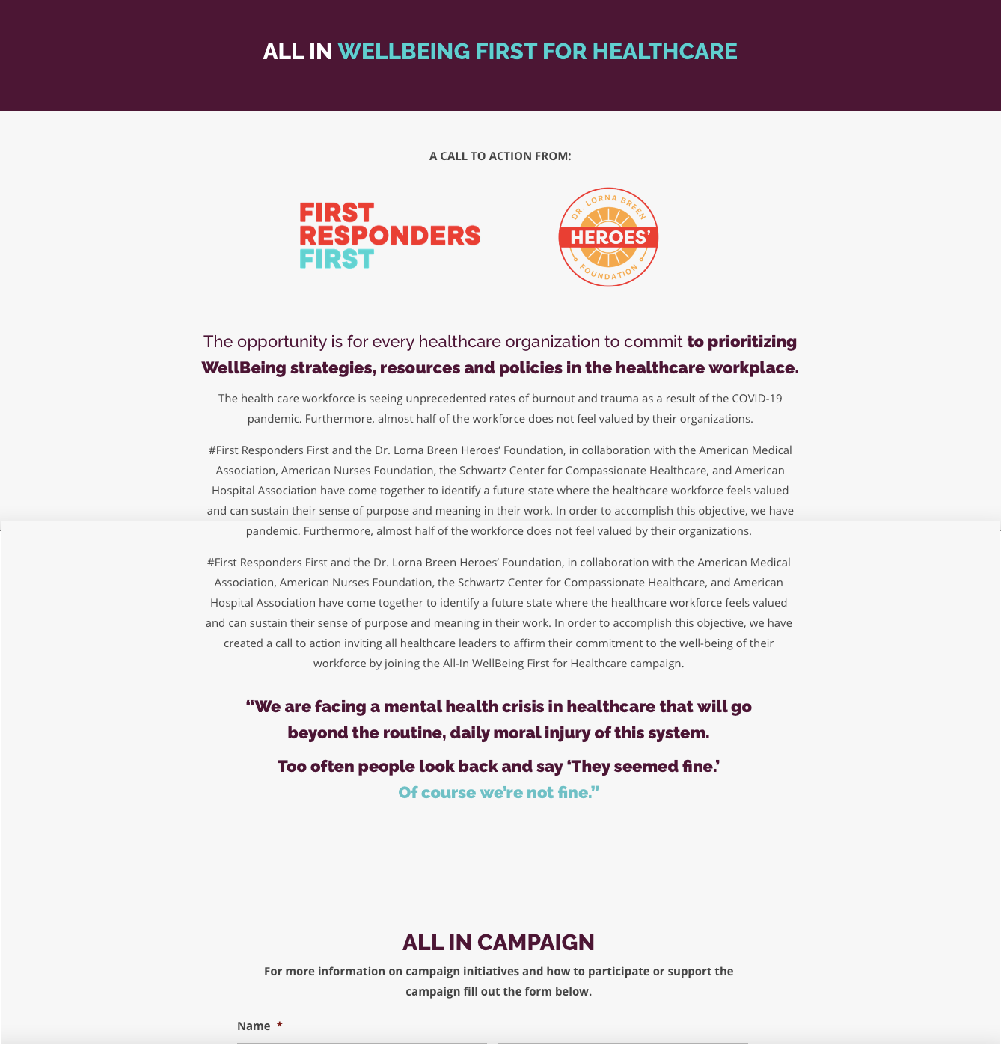
Create a Culture of Wellbeing
Commit to reducing burnout, safeguarding job satisfaction and viewing seeking mental health services as a sign of strength, by joining the ALL IN: WellBeing First for Healthcare campaign.

Slide 20
Get Help
If you are in crisis or experiencing difficult or suicidal thoughts, call the National Suicide Hotline at 1-800-273-TALK (8255) for free 24/7 support.

Slide 21

Join us in preventing physician suicide.
Become a Supporting Organization at NPSADay.org/become-supporting-organization
Reach out and engage physicians, their loved ones, their colleagues, health organizations or others in your network to join us in recognizing #NPSADay.
Access at NPSADay.org/toolkit:
Guides to help you plan how to recognize #NPSADay
Shareable materials to recognize #NPSADay and encourage others to help prevent physician suicide
Brought to you by:

