Slide 1





Vital Signs: The Campaign to Prevent Physician Suicide

Slide 2



Physicians have one of the highest suicide rates of any profession. More than half of physicians know a physician who has either considered, attempted or died by suicide in their career. It’s estimated that one million Americans lose their physician to suicide each year.
We can all help prevent physician suicide.
Physicians are experiencing practice environments like they never had before -- early physician retirement, health care worker shortages and a growing inequity experienced by patients. Understandably, this has taken a toll on their mental health and contributes to burnout rates.
National Physician Suicide Awareness Day (#NPSADay) is a reminder and call to action. It's a time to talk – and to act – so physicians’ struggles don't become mental health emergencies. We can all help prevent physician suicide by learning the signs, starting the conversations, creating a culture of wellbeing, removing intrusive mental health questions from applications and sharing the resources that can help those in distress seek mental health care.

Slide 3

7 Actions You Can Take
Learn the Vital Signs
Encourage mental health reflection
Share suicide prevention resources
Prepare before a moment of crisis
Check in with a physician
Remove intrusive mental health questions
Create a culture of wellbeing

Slide 4


Slide 5

Learn the Warning Signs with the Vital Signs’ HEART Acronym
Vital Sign 1: Health
  Increasing the use of medications and/or alcohol or illicit drugs
  Talking about wanting to hurt themselves or die

Slide 6
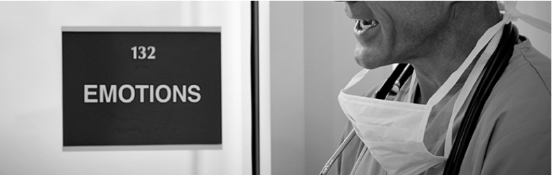
Learn the Warning Signs with the Vital Signs’ HEART Acronym
Vital Sign 2: Emotions
  Experiencing extreme mood swings
  Feeling hopeless or having no purpose

Slide 7

Learn the Warning Signs with the Vital Signs’ HEART Acronym
Vital Sign 3: Attitude
  Being negative about professional and personal life
  Having inappropriate outbursts of anger or sadness

Slide 8

Learn the Warning Signs with the Vital Signs’ HEART Acronym
Vital Sign 4: Relationships
  Withdrawing or isolating themselves from family, friends and coworkers
  Talking about being a burden to others

Slide 9

Learn the Warning Signs with the Vital Signs’ HEART Acronym
Vital Sign 5: Temperament
  Acting anxious or agitated; behaving recklessly
  Being uncomfortable, tired or in unbearable pain

Slide 10
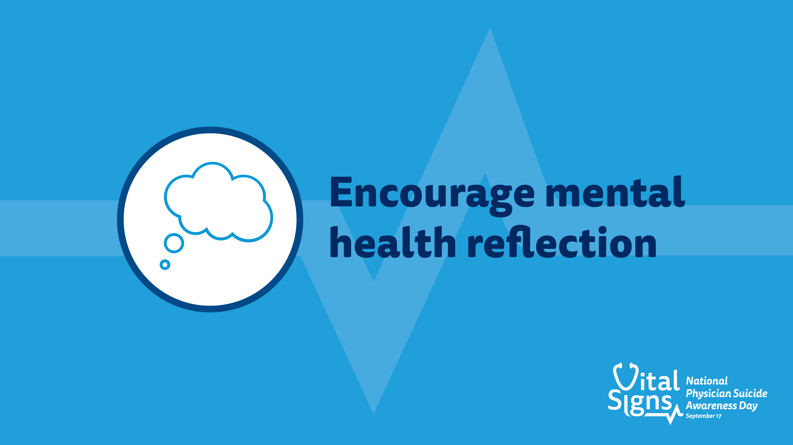

Slide 11
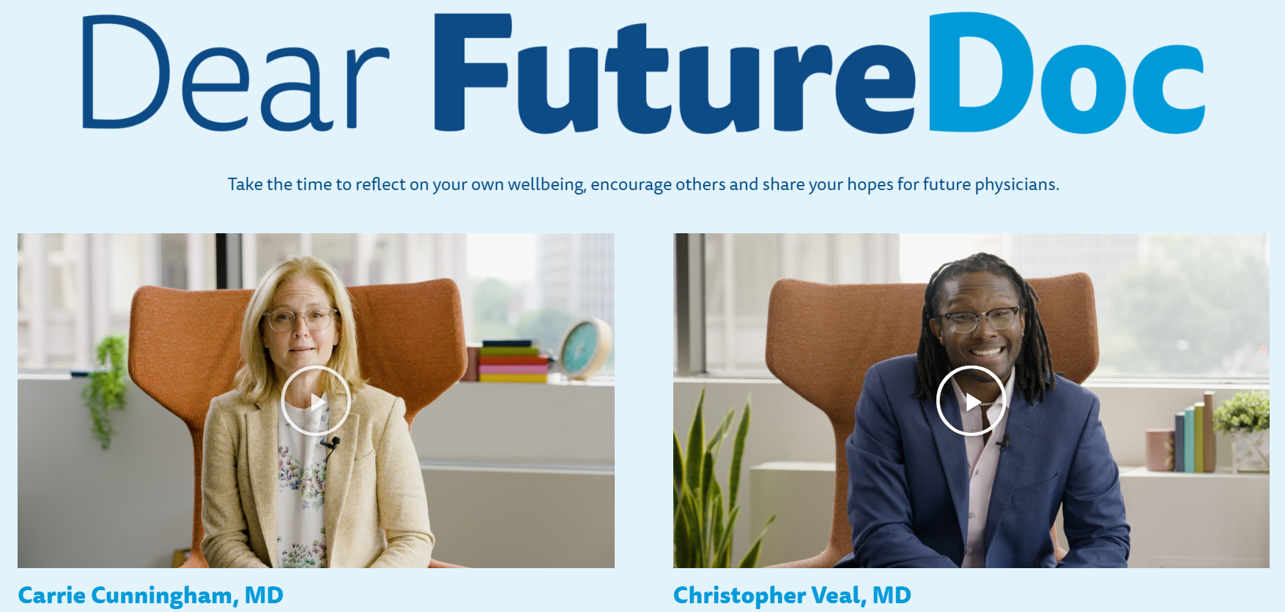
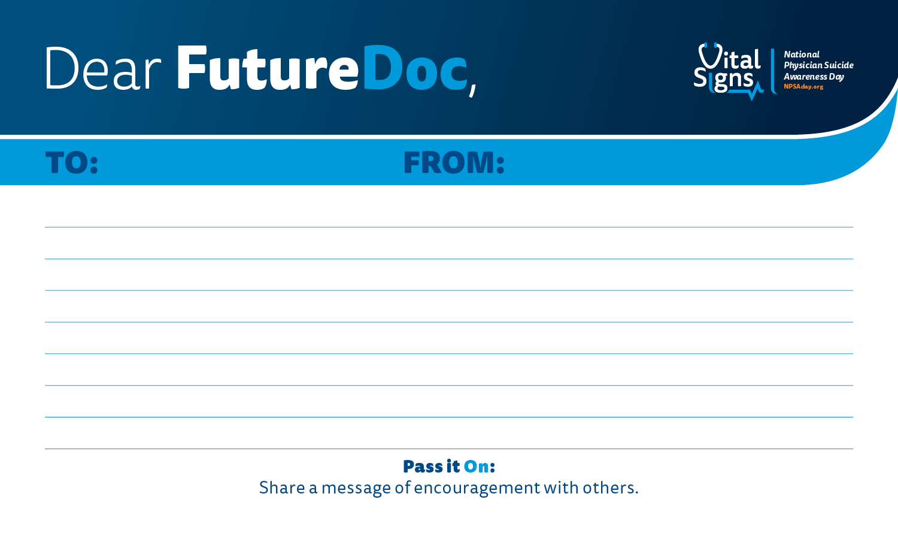

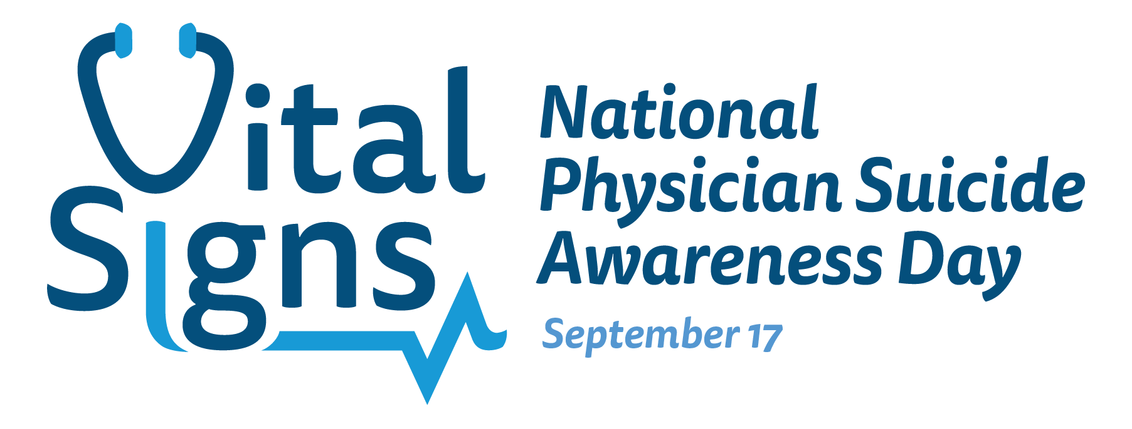
Encourage Mental Health Reflection
Dear FutureDoc allows medical students, residents and physicians an opportunity to:
Reflect on your own mental health and wellbeing using Dear FutureDoc notecards to write a message to your future self.
Reflect on your wellbeing hope for future physicians.
Share a video about your hope for future physicians.

Slide 12
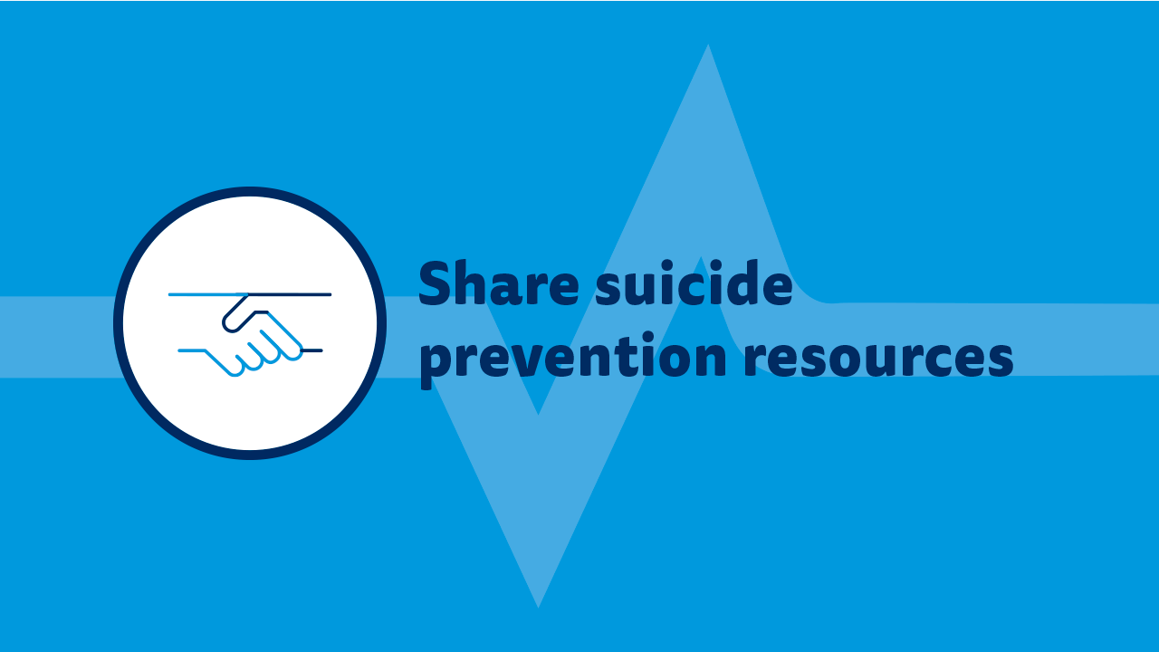

Slide 13
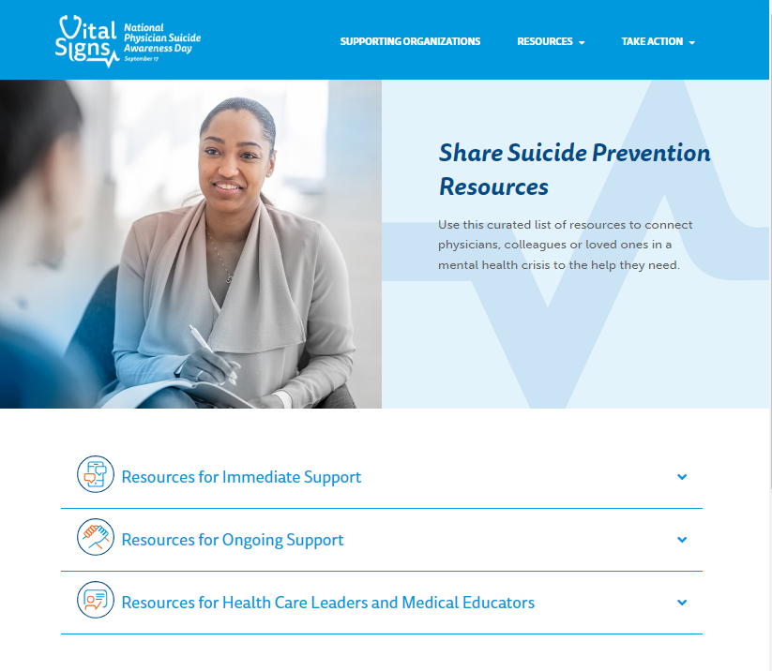
Share Suicide Prevention Resources
Stressors are inevitable in the field of medicine, but many prevention resources can help provide support.
If you or someone you know is struggling or in crisis, call or text 988 or chat 988lifeline.org

Slide 14
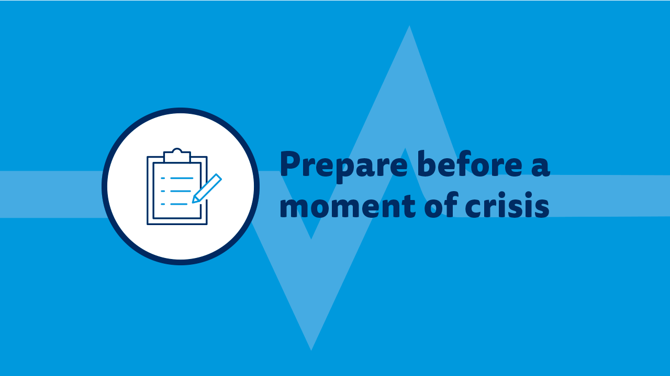

Slide 15
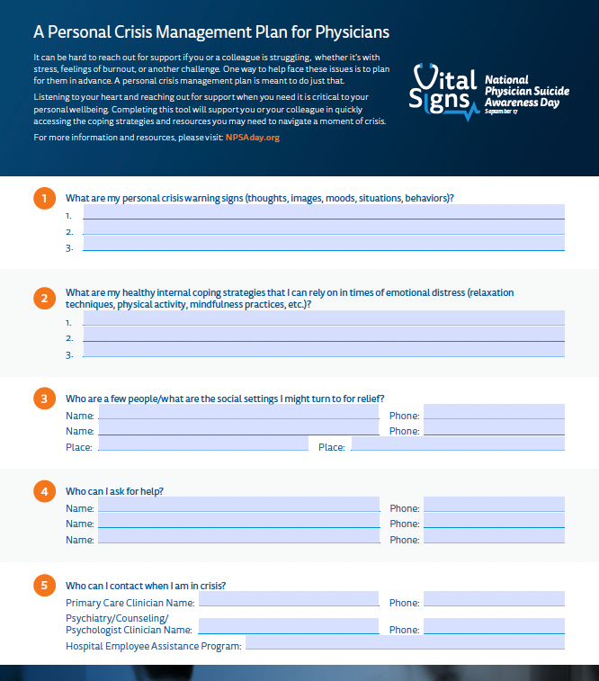
Prepare Before a Moment of Crisis
It can be hard to reach out for support if you or a colleague is struggling, whether it’s with stress, feelings of burnout or another challenge.
One way to help face these issues is to plan for them in advance. A personal crisis management plan is meant to do just that.

Slide 16
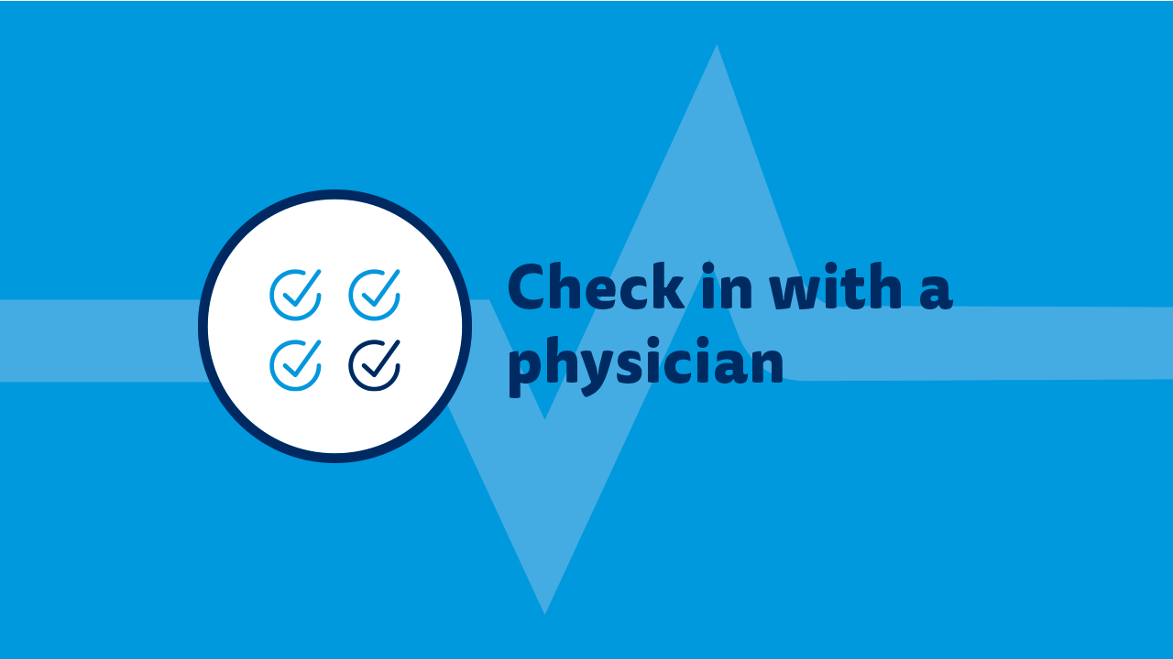

Slide 17
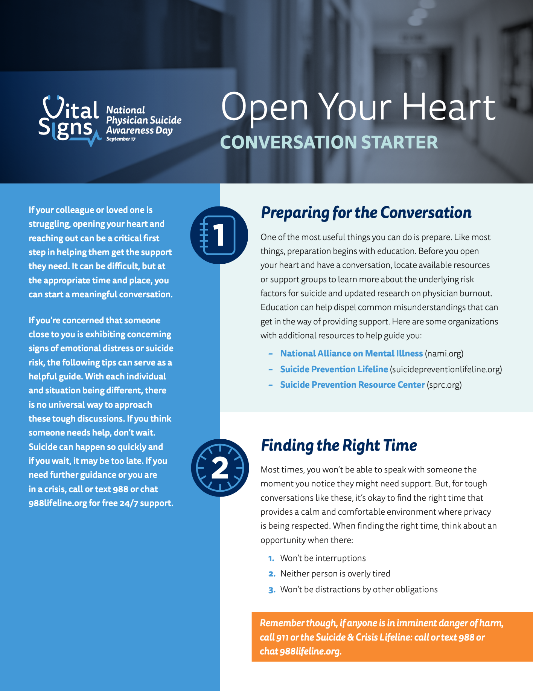
Start a Meaningful Conversation
1. Prepare for the conversation
2. Find the right time
3. Choose the right language
4. Listen, actively
5. Navigate resistance

Slide 18
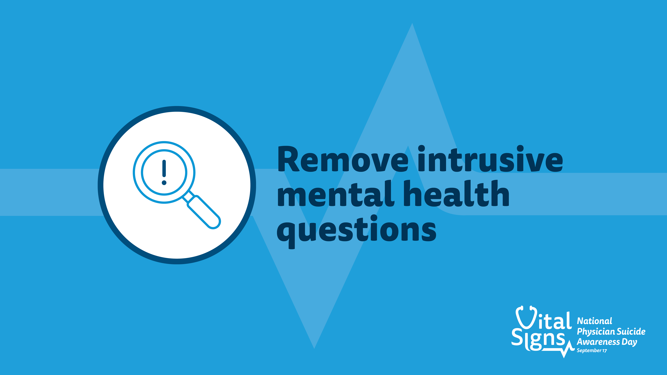

Slide 19

Remove Intrusive Mental Health Questions
3 Steps Boards and Hospitals/Health Systems Can Take
AUDIT all licensure and credentialing applications, addendums and peer review forms
CHANGE any invasive or stigmatizing language around mental health
COMMUNICATE these changes to your workforce and assure clinicians that it is safe for them to seek care

Slide 20


Slide 21


Create a Culture of Wellbeing
ALL IN: Caring for Caregivers is a program for organizations to improve the professional well-being and mental health of health workers. It includes three main phases:
1) Commitments by Medical Groups, Hospitals, Health Systems, Health Plans
2) Digital Programming – Symphony
3) Focus on Operations and Participate in Learning Communities

Slide 22
Get Help
If you or someone you know is struggling or in crisis, call or text 988 or chat 988lifeline.org

Slide 23

Join us in preventing physician suicide.
Become a Supporting Organization at NPSADay.org/become-supporting-organization
Reach out and engage physicians, their loved ones, their colleagues, health organizations or others in your network to join us in recognizing #NPSADay.
Access at NPSADay.org/toolkit:
Guides to help you plan how to recognize #NPSADay
Shareable materials to recognize #NPSADay and encourage others to help prevent physician suicide
Brought to you by:

